Slide 1
Turing Machines
Module - 6

Slide 2
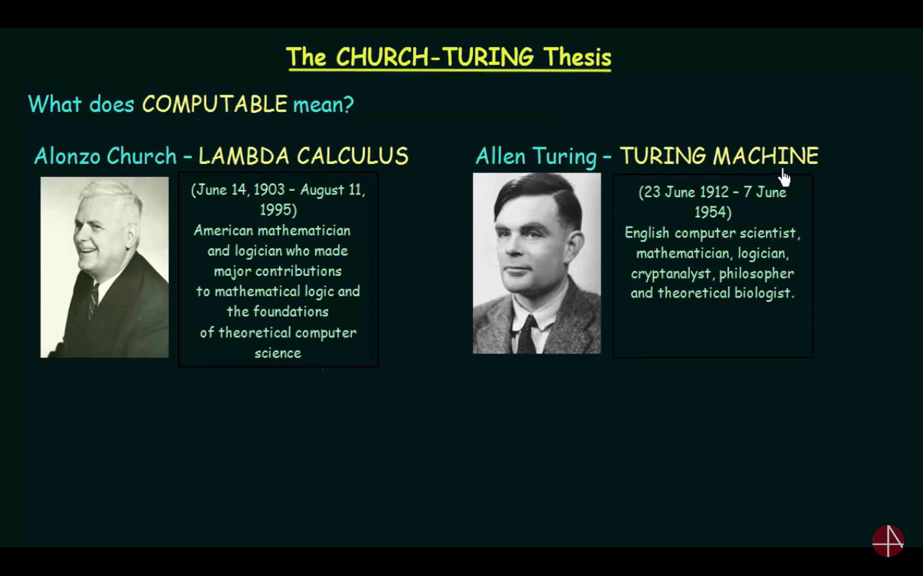
The Church Turing Thesis
A computable function is a function that a Turing Machine can compute.
Alonzo Church and Alan Turing showed
Anything that can be computed can be computed by Turing Machine
Only functions that are computable by TM are computable
There is no such computing problem that TM cannot compute

Slide 3
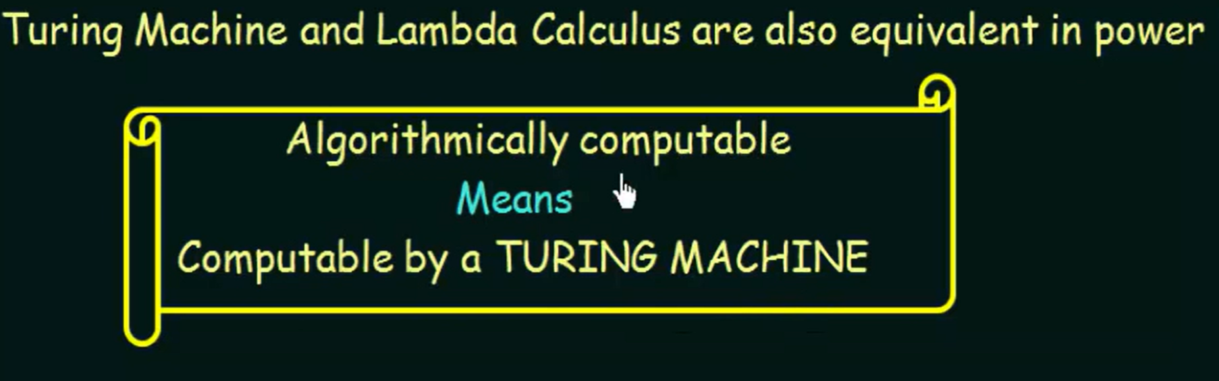
Cont…
Multiple attempts have been made to enhance / modify the design of TM to make it more powerful.
Like multi-head, multi-tapes, multi-track, allow non-determinism,… [Variations in TM]
However, all the resulting variations turned out to be strictly equivalent to the standard Turing machine in terms of the set of the functions that it can complete thereby, supporting Church Turing Thesis.

Slide 4
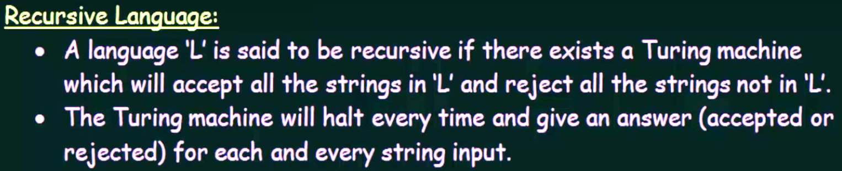
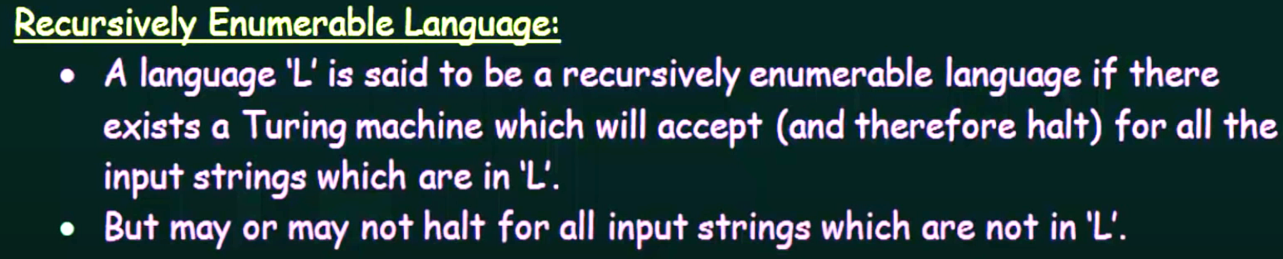
Recursive and Recursively Enumerable languages

Slide 5

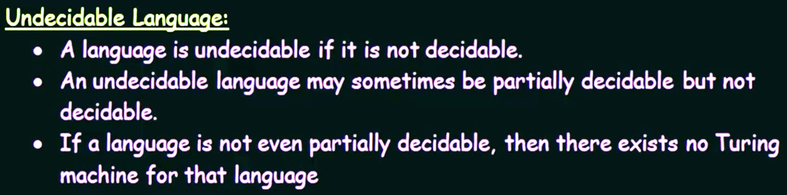
Decidability and Un-decidability

Slide 6
Halting Problem
Deals with two decision problems:
Accepts: Given a TM, T and a string w, is w ϵ L(T).
Halts: Given a TM, T and a string w, does T halt on input, w.
Can be stated in two ways, for a given TM and string, w
Does the TM accepts the string, w?
Whether TM halts by accepting / rejecting the string, w?

Slide 7
Halting Problem
Given an arbitrary TM and arbitrary input for the machine, then is it possible to determine whether the machine will ever halt on given input? This is called halting problem.
That means we are asking for a procedure which enable us to solve the halting problem for every pair (machine & input). The answer is “no”. That is halting problem is unsolvable.

Slide 8
Halting Problem is undecidable
Input − A Turing machine and an input string w.
Problem − Does the Turing machine finish computing of the string w in a finite number of steps? The answer must be either yes or no.
Proof − At first, we will assume that such a Turing machine exists to solve this problem and then we will show it is contradicting itself. We will call this Turing machine as a Halting machine that produces a ‘yes’ or ‘no’. If the halting machine finishes in a finite amount of time, the output comes as ‘yes’, otherwise as ‘no’.

Slide 9
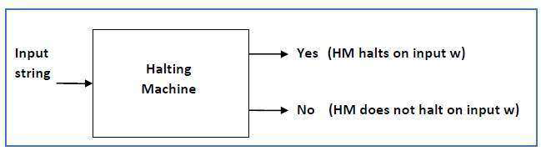
Cont..,
The block diagram of a Halting machine −

Slide 10
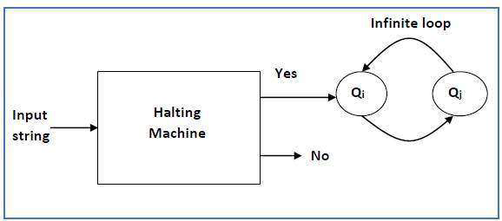
Cont..,
Now we will design an Inverted Halting Machine (HM)₂ as −
If H returns YES, then loop forever.
If H returns NO, then halt.
The block diagram of an ‘Inverted halting machine’ −

Slide 11
Cont..,
Further, a machine (HM)₂ in which input itself is constructed as follows −
If (HM)₂ halts on input, loop forever.
Else, halt.
Here, we have got a contradiction. Hence, the halting problem is undecidable.

